Slide 1
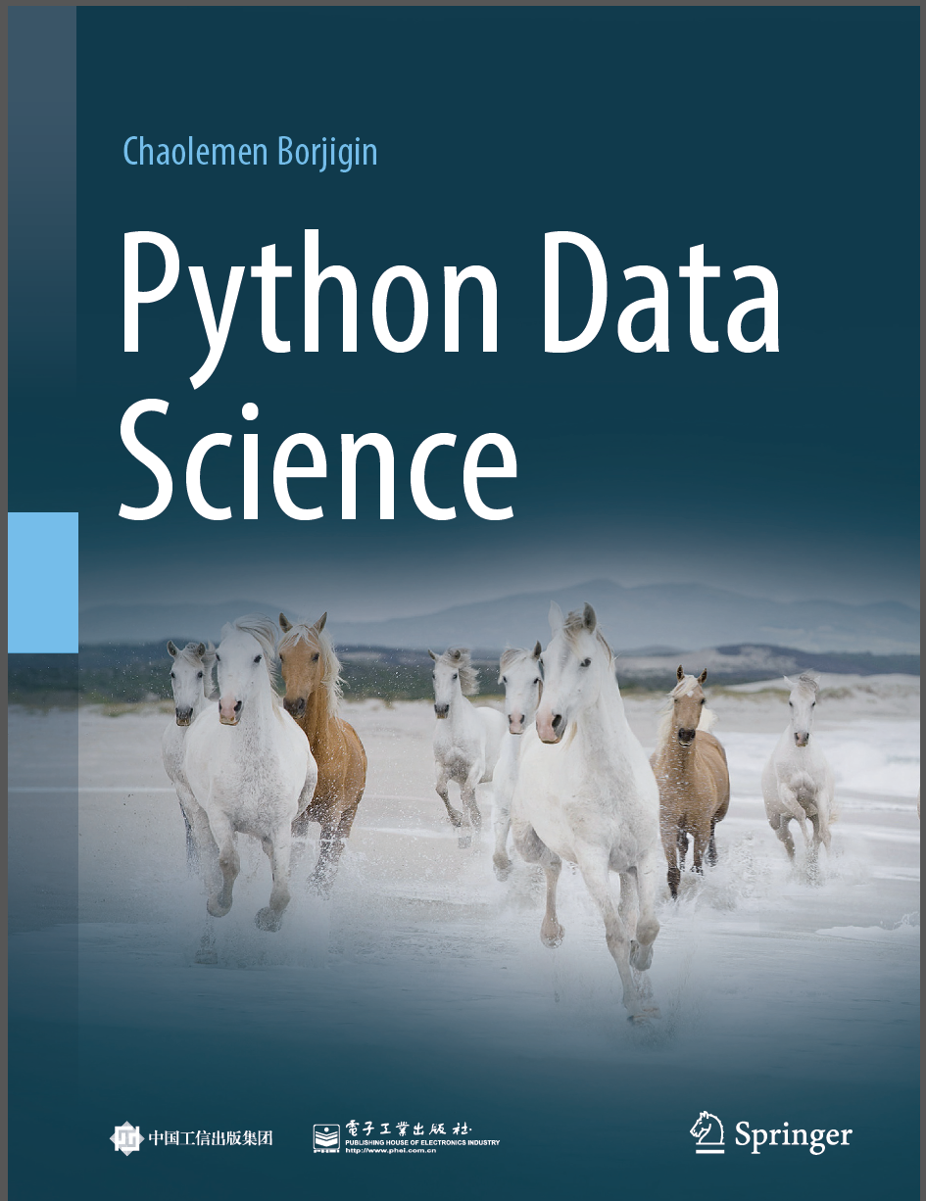
Python Data Science
Chaolemen Borjigin
Renmin University of China
chaolemen@ruc.edu.cn

Slide 2
1.3 How to write and run my Python codes
▼ Chapter 1 Python and Data Science
► 1.3 How to write and run my Python codes
Chaolemen Borjigin
Renmin University of China
chaolemen@ruc.edu.cn

Slide 3
Summary of this chapter
▼ Chapter 1 Python and Data Science
► 1.3 How to write and run my Python codes
1.3.1 Inputs
1.3.2 Outputs
1.3.3 Errors and warnings
1.3.4 External data files
1.3.5 Tips for Python programming

Slide 4
1.3.1 Inputs
▼ Chapter 1 Python and Data Science
► 1.3 How to write and run my Python codes
In[1]:
x1=11
x1
In[2]:
x2=12
x2
In[3]:
x3=13
x3)

Slide 5
1.3.1 Inputs
▼ Chapter 1 Python and Data Science
► 1.3 How to write and run my Python codes
In[4]:
x4=14
In[5]:
x4=x4+1
x4
In[6]:
x5=5
x5
Out[6]:
5

Slide 6
1.3.2 Outputs
▼ Chapter 1 Python and Data Science
► 1.3 How to write and run my Python codes
In[7]:
y1=21
y1
Out[7]:
21
In[8]:
y2=22
y2
Out[8]:
22

Slide 7
1.3.2 Outputs
▼ Chapter 1 Python and Data Science
► 1.3 How to write and run my Python codes
In[9]:
y3=23
print(y3)
23

Slide 8
1.3.3 Errors and warnings
▼ Chapter 1 Python and Data Science
► 1.3 How to write and run my Python codes
In[10]:
z1=31
z
---------------------------------------------------------------------------
NameError Traceback (most recent call last)
<ipython-input-10-8d66e1a13261> in <module>()
1 z1=31
----> 2 z
NameError: name 'z' is not defined

Slide 9
1.3.4 External data files
▼ Chapter 1 Python and Data Science
► 1.3 How to write and run my Python codes
In[11]:
import os
print(os.getcwd())
C:\Users\soloman\clm
In[12]:
from pandas import read_csv
data = read_csv('bc_data.csv')
data.head(2)

Slide 10
1.3.4 External data files
▼ Chapter 1 Python and Data Science
► 1.3 How to write and run my Python codes
Out[12]:
 | id | diagnosis | radius_mean | texture_mean | perimeter_mean | area_ mean | smoothness_mean
0 | 842302 | M | 17.99 | 10.38 | 122.8 | 1001.0 | 0.11840
1 | 842517 | M | 20.57 | 17.77 | 132.9 | 1326.0 | 0.08474
2 rows × 32 columns

Slide 11


